Slide 1
APPROACHES TO KNOWLEDGE REPRESENTATION

Slide 2
What is Knowledge?
The Chambers 20th Century Dictionary provides as good a definition as any:
knowledge, nol′ij, n. assured belief; that which is known; information; …
In order to solve the complex problems encountered in AI, one generally needs a large amount of knowledge, and suitable mechanisms for representing and manipulating all that knowledge.
Knowledge can take many forms. Some simple examples are:
John has an umbrella
It is raining
An umbrella stops you getting wet when it’s raining
An umbrella will only stop you getting wet if it is used properly
Umbrellas are not so useful when it is very windy
So, how should an AI agent store and manipulate knowledge like this?

Slide 5
What is a Knowledge Representation?
The object of a knowledge representation is to express knowledge in a computer tractable form, so that it can be used to enable our AI agents to perform well.
A knowledge representation language is defined by two aspects:
1. Syntax The syntax of a language defines which configurations of the components of the language constitute valid sentences.
2. Semantics The semantics defines which facts in the world the sentences refer to, and hence the statement about the world that each sentence makes.
This is a very general idea, and not restricted to natural language.
Suppose the language is arithmetic, then ‘x’, ‘≥’ and ‘y’ are components (or symbols or words) of the language the syntax says that ‘x ≥ y’ is a valid sentence in the language, but ‘≥ ≥ x y’ is not the semantics say that ‘x ≥ y’ is false if y is bigger than x, and true otherwise

Slide 6
Requirements of a Knowledge Representation
A good knowledge representation system for any particular domain should possess the
following properties:
1. Representational Adequacy – the ability to represent all the different kinds of knowledge that might be needed in that domain.
2. Inferential Adequacy – the ability to manipulate the representational structures to derive new structures (corresponding to new knowledge) from existing structures.
3. Inferential Efficiency – the ability to incorporate additional information into the knowledge structure which can be used to focus the attention of the inference mechanisms in the most promising directions.
4. Acquisitional Efficiency – the ability to acquire new information easily. Ideally the agent should be able to control its own knowledge acquisition, but direct insertion of information by a ‘knowledge engineer’ would be acceptable.
Finding a system that optimises these for all possible domains is not going to be feasible.

Slide 7
Practical Aspects of Good Representations
In practice, the theoretical requirements for good knowledge representations can usually be achieved by dealing appropriately with a number of practical requirements:
1. The representations need to be complete – so that everything that could possibly need to be represented, can easily be represented.
2. They must be computable – implementable with standard computing procedures.
3. They should make the important objects and relations explicit and accessible – so that it is easy to see what is going on, and how the various components interact.
4. They should suppress irrelevant detail – so that rarely used details don’t introduce unnecessary complications, but are still available when needed.
5. They should expose any natural constraints – so that it is easy to express how one object or relation influences another.
6. They should be transparent – so you can easily understand what is being said.
7. The implementation needs to be concise and fast – so that information can be stored, retrieved and manipulated rapidly.

Slide 8
Components of a Good Representation
For analysis purposes it is useful to be able to break any knowledge representation down into their four fundamental components:
1. The lexical part – that determines which symbols or words are used in the representation’s vocabulary.
2. The structural or syntactic part – that describes the constraints on how the symbols can be arranged, i.e. a grammar.
3. The semantic part – that establishes a way of associating real world meanings with the representations.
4. The procedural part – that specifies the access procedures that enables ways of creating and modifying representations and answering questions using them, i.e. how we generate and compute things with the representation.

Slide 9
Knowledge Representation in Natural Language
Humans usually use natural language (English, Spanish, Chinese, etc.) to represent knowledge, so why not use that to represent knowledge in our AI systems?
Advantages of Natural Language
1. It is extremely expressive – we can express virtually everything in natural language(real world situations, pictures, symbols, ideas, emotions, reasoning, …).
2. Most humans use it most of the time as their knowledge representation of choice (how many text books are not written in natural language?).
Disadvantages
1. Both the syntax and semantics are very complex and not fully understood.
2. There is little uniformity in the structure of sentences.
3. It is often ambiguous – in fact, it is usually ambiguous.

Slide 10
Approaches to Knowledge Representation
Relational Knowledge
Knowledge represented as Logic
Procedural Logic

Slide 11
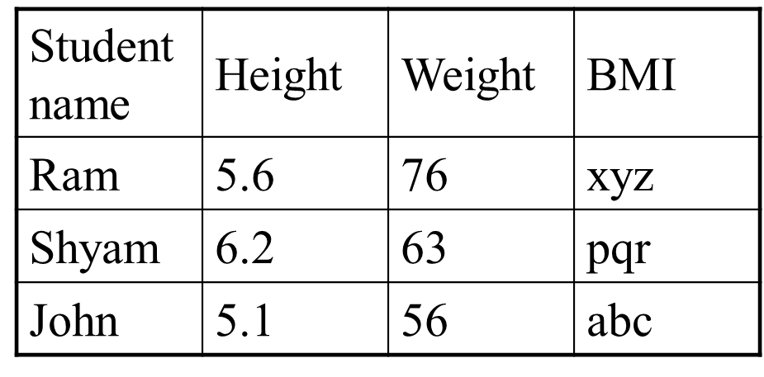
1. Relational Knowledge
Examine tables as a knowledge representation scheme
How do tables fair in terms of
Adequacy
Inference
Acquisition ?
Consider the question “Which student is the tallest?”
Without a procedure to calculate max, the question cannot be answered. (Needs Inferencing)

Slide 12
2. Knowledge represented as Logic
There are various forms of logic, of which the simplest is probably propositional calculus (also known as sentence logic), and the most commonly used in AI is first order predicate calculus (also known as first order predicate logic).

Slide 13
Propositional Logic
It is raining ➔ RAINING
It is sunny ➔ SUNNY
We can deduce whether a certain
proposition is true or false
Socrates is a man ➔ SOCRATESMAN
Plato is a man ➔ PLATOMAN
We can not draw any conclusions about
Similarities between Socrates and Plato

Slide 14
Predicate Logic
Socrates is a man ➔ MAN (SOCRATES)
Plato is a man ➔ MAN (PLATO)
Now the structure of representation reflects
the structure of knowledge
All Romans were either loyal to Caesar or hated him ➔
It is difficult to represent knowledge in predicate logic
with only THERE EXISTS, ALL, AND, OR

Slide 15
3. Procedural Logic
Here knowledge is encoded in the form of procedures which carry out specific tasks based on relevant knowledge.
For example, an interpreter for a programming language interprets a program based on the knowledge regarding the syntax and semantics of the language used.
Advantage of this approach is that domain specific knowledge can be easily represented and modelled.
Problems are completeness and consistency, that is all cases may not be represented and all deductions may not be correct .

